Slide 1
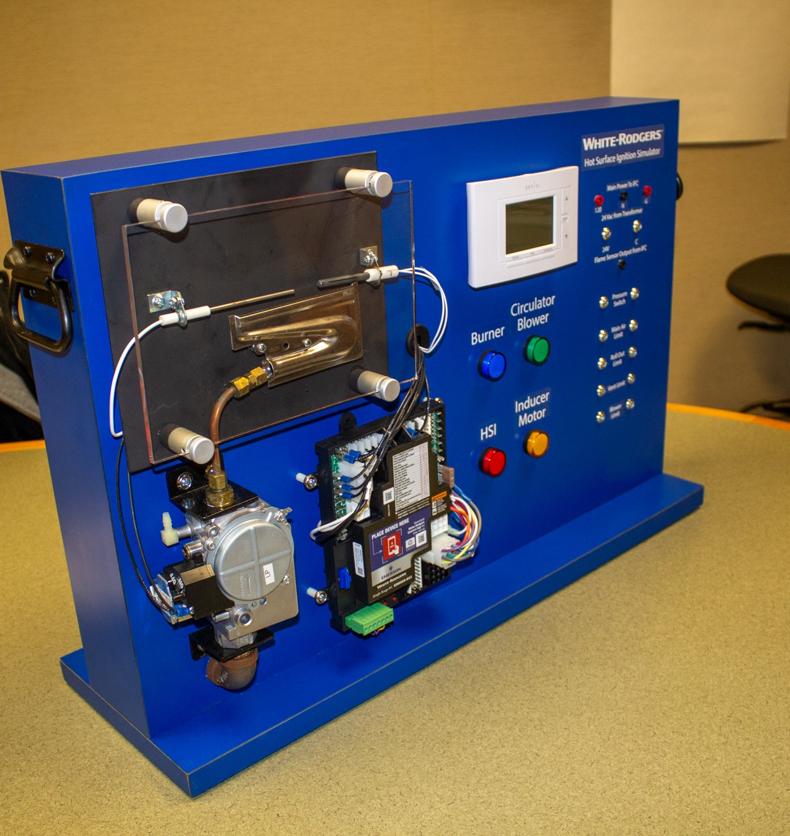
Residential Gas Valves
HSI Simulator Presentation

Slide 2
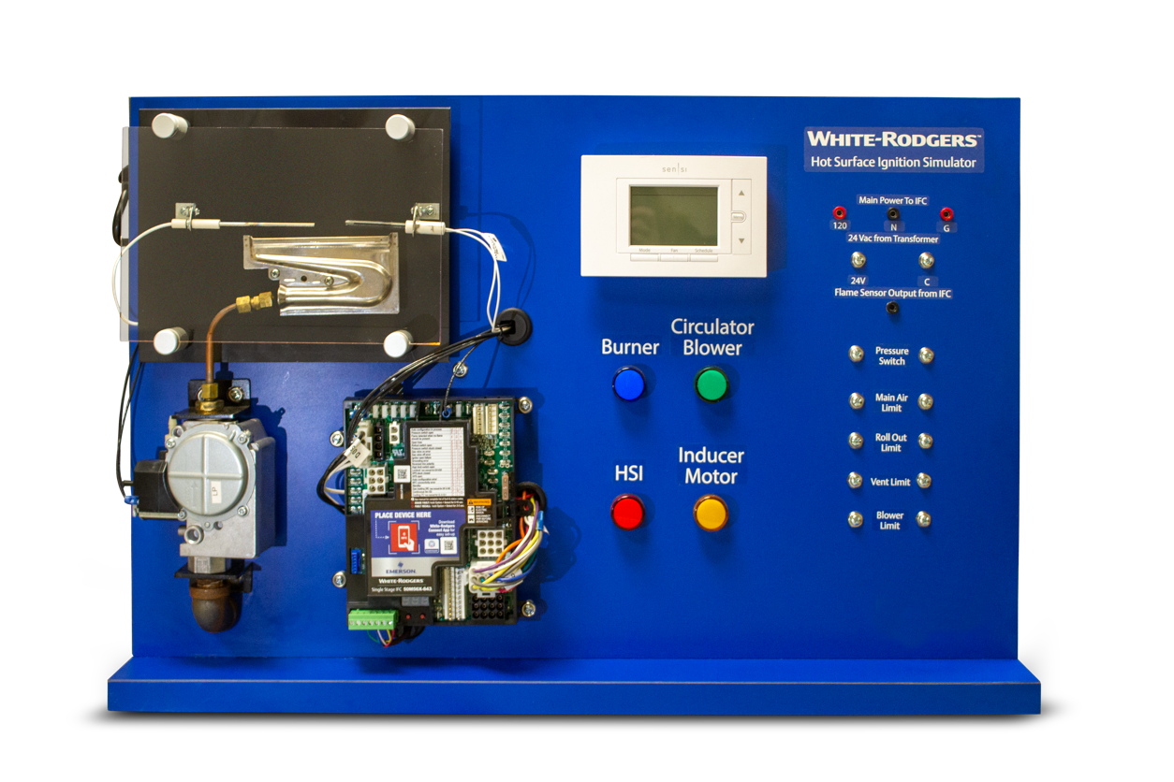
Course Agenda
Part One | Gas Valve Operation
Part Two | Choosing the Correct Replacement Valve
Part Three | Replacing Gas Valves
Part Four | Troubleshooting and Servicing Gas Valves

Slide 3
Gas Valve Operation
Part one

Slide 4
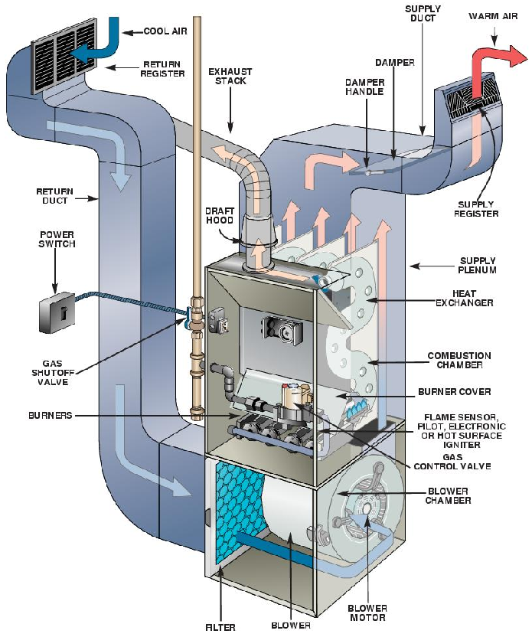
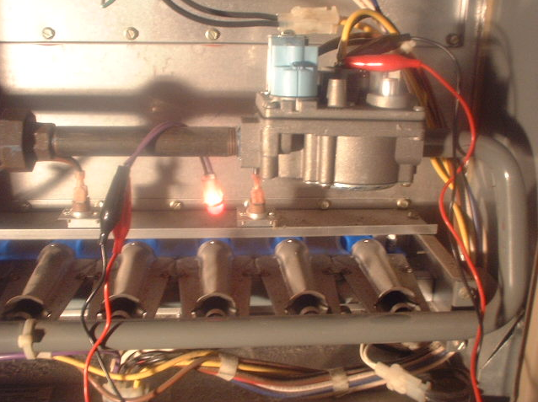
What is a Gas Valve?
A gas valve is an automated valve that controls the pressure of the fuel supplied to the main burner.
The gas valve starts and stops the flow of fuel and controls the pressure the fuel is supplied to the burners.

Slide 5
A Basic Gas Train
The modern automatic gas valve combines the previously separate pilot valve, regulator, and solenoid valve.
Furnace
Fuel supply
Pilot valve
Pilot Burner
Shut off valve
Main burner
Union
Regulator
Solenoid valve
Notes:
Having the shut off, pilot valve, regulator, and solenoid all piped in series was common on early natural gas furnaces.
The modern gas valve combined all but the shut off into one component.

Slide 6
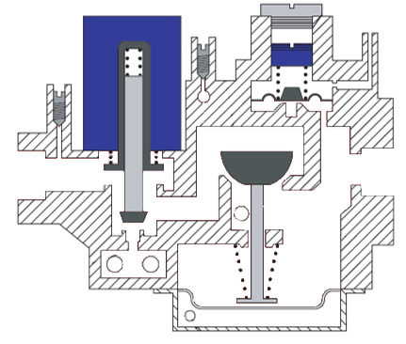
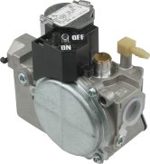

Gas Valve Main Components
Valve solenoid
Pressure tap inlet
Redundant valve
Main valve
Supply inlet
Diaphragm
Regulator valve
Main burner outlet
Regulator adjustment spring
Regulator adjust screw
Pressure tap outlet
1
11
10
2
9
3
8
36J Series Gas Valve
5
4
7
6
Notes:
This cutaway of a gas valve shows the solenoid (1) that actuates the main valve (4).
The solenoid also actuates the redundant valve (3), which serves as a master shut off if the main valve fails.
The regulator is made up of the spring (9) and adjustment screw (10), as well as the diaphragm (6) and regulator valve (7).
The pressures that act on the diaphragm actually pass through channels in the valve body, and will be discussed later in this presentation.

Slide 7
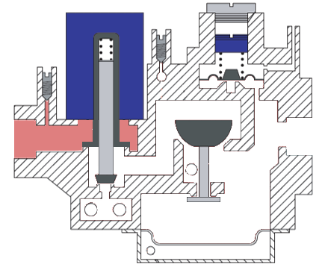
Gas Valve Operation
Normal operation with no voltage applied to solenoid.
Valve Redundant valve closed
Main valve closed
Continuous inlet pressure from supply line
Regulator valve will not open without pressure applied
3
1
2
4
Notes:
This image shows the gas valve in its closed, or idle, state.
The furnace is not running, and there is no active call for heat.
The solenoid is not energized and the spring has closed both the main and redundant valves.
The lack of gas pressure in the regulator portion has allowed the regulator valve to settle into its idle state as well.
No gas is flowing through the valve at this time.
The listed pressures in this presentation will refer to natural gas unless otherwise noted. A gas valve that has been converted for propane use will have different operating pressures

Slide 8
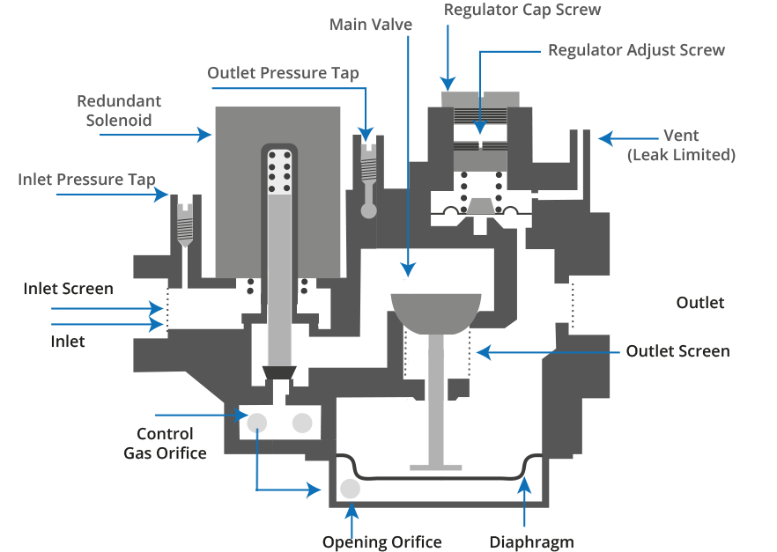
Gas Valve Operation
When the solenoid is energized, the redundant and main valves open.
Continuous inlet pressure from supply line.
An internal channel connecting the control gas orifice to the opening orifice allows pressurized gas into the back side of diaphragm, forcing the regulator valve open.
Pressurized gas also passes internally to the adjustable regulator, where it supplies back-pressure on the main diaphragm, only allowing it to open to set pressure.
Outlet pressure to manifold.
Regulator Valve
When the solenoid is energized, the redundant
and main valves open.
Continuous inlet pressure from supply line
An internal channel connecting the control gas orifice to the opening orifice allows pressurized gas into the back side of diaphragm, forcing the regulator valve open
Pressurized gas also passes internally to the adjustable regulator, where it supplies back-pressure on the main diaphragm, only allowing it to open to set pressure
Outlet pressure to manifold
Notes:
Once there is an active call for heat, 24 Volts is applied to the solenoid coil, drawing both the redundant and main valves open.
The redundant valve controls the flow of gas to the rest of the valve, whereas the main valve controls the flow of gas to the opening orifices
When the main valve opens, it floods the back side of the regulator diaphragm, causing the regulator valve to open
Pressurized gas fills the chambers of the valve.
In this case, it is pressurized at 7 inches of water column (“W.C.)
The gas pressure travels through the Control Gas Orifice to the back side of the diaphragm and causes it to flex and open the regulator valve.
This allows the gas to pass through the valve to the outlet.
Simultaneously, gas pressure travels through another orifice to the regulator adjustment.
The regulator adjustment allows a specific pressure to pass through and apply pressure to the top side of the diaphragm
This pressure only allows the regulator to open enough to let 3.5 “W.C. pass through the regulator valve
If the inlet pressure increases, this pressure also increases and maintains a consistent outlet pressure

Slide 9
Gas Valve Operation
Normal operation with no voltage applied to solenoid.
Redundant valve closed
Main valve closed
Inlet pressure 7 “W.C. natural gas
No pressure opening regulator
3
1
2
4
Notes:
This image shows the gas valve in its closed, or idle, state.
The furnace is not running, and there is no active call for heat.
The solenoid is not energized and the spring has closed both the main and redundant valves.
The lack of gas pressure in the regulator portion has allowed the regulator valve to settle into its idle state as well.
No gas is flowing through the valve at this time.

Slide 10
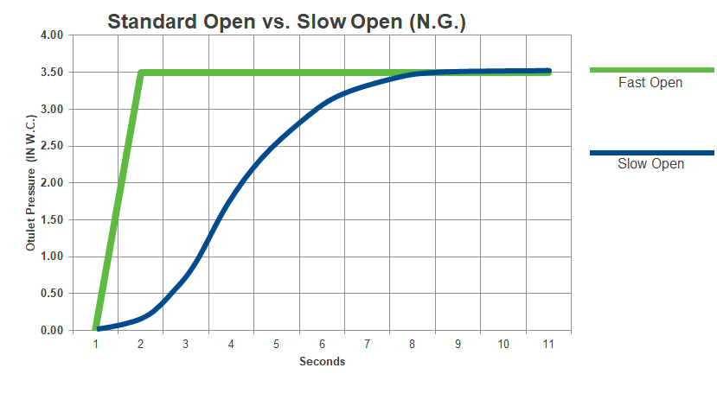
Standard (Fast) Open Curve
A standard open gas valve will immediately go to full pressure and hold.
A slow open gas valve will take 8 seconds to get to full pressure.
TECH TIP: Slow opening gas valves provide a gradual increase in outlet pressure for a smoother ignition.
Notes:
A fast opening gas valve can result in a sudden but controlled burst of flame with initially a small amount of rollout until the draft can catch up
A slow opening gas valve will have a much smoother ignition that does not overpower the draft

Slide 11
Slow Open Gas Valve Operation
Decreasing the opening orifice slows the buildup of pressure on the back side of the regulator diaphragm.
Continuous inlet pressure from
supply line
Outlet pressure to manifold
Opening orifice
1
2
3
Notes:
A smaller diameter orifice causes the pressure to take longer to build up on the back side of the main diaphragm
This results in the main valve taking more time to rise into the fully open position

Slide 12
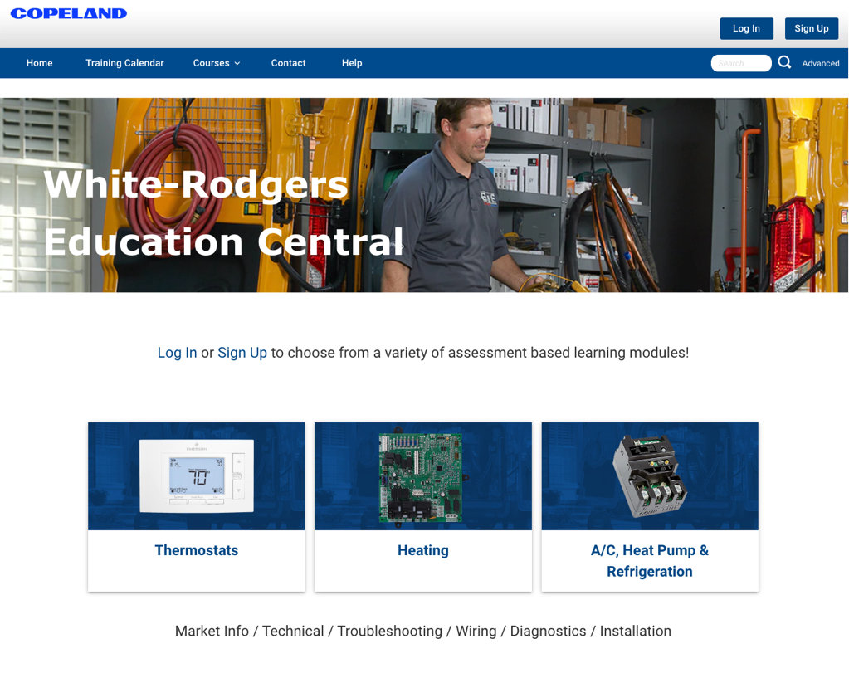
Key Takeaways
Gas valves automatically control the pressure of the fuel supplied to the burners
A modern automatic gas valve contains a solenoid valve, a pressure regulator, and if needed, a pilot valve
Gas valves are often classified by the amount of time they take to fully open
The regulator portion of a gas valve must be vented for proper operation
For more information on how automatic gas valves operate visit us on White Rodgers Education Central https://go.bluevolt.com/whiterodgers/s/?brand=whiterodgers

Slide 13

Wholesale Resource Site
Access useful resources to grow your business.
Visit: White-Rodgers Resource Center | Copeland US You’ll find videos, stocking lists, online digital catalog and product launch information for the following product families:
Heating Controls
Cooling Controls
Sensi Smart™ Thermostats
Traditional Thermostats
Contractor Rewards
Product Merchandising

Slide 14
Choosing the Correct Replacement Valve
Part Two

Slide 15
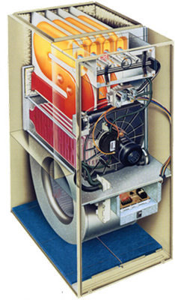
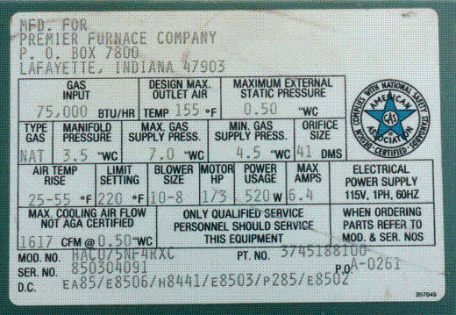
Choosing the Correct Replacement Valve
Gas valves are classified by:
Ignition source
  Standing/cycle pilot
  Proven/intermittent pilot
  Direct burner
    Hot surface ignition (HSI)
    Direct spark ignition (DSI)
BTU input and output
  Capacity is found on the rating plate
Opening characteristics
  Fast open
  Slow open
  Two-stage
Notes:
To replace an existing gas valve, you must know the ignition source, the BTU capacity, and the opening characterisitcs

Slide 16
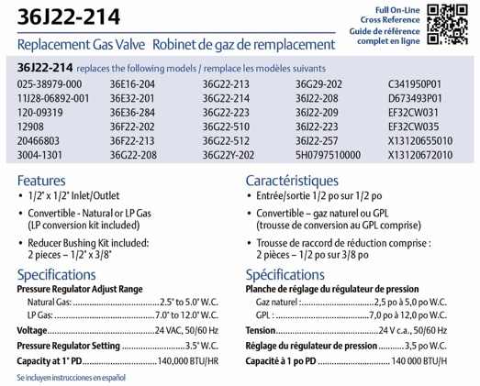

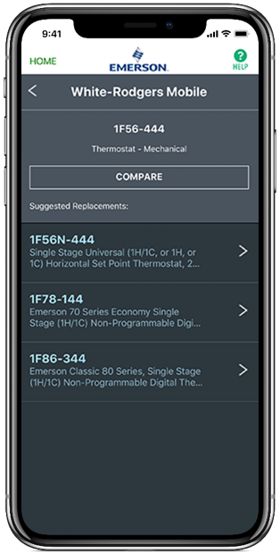
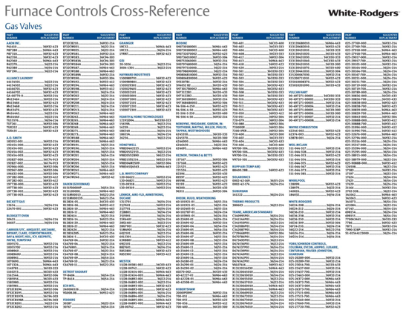
Choosing the Correct Replacement Valve
More information can be located by referencing the defective valve part number:
On the box
Visor card
WR Mobile
Catalog
Box
Cross Reference
WR Mobile

Slide 17




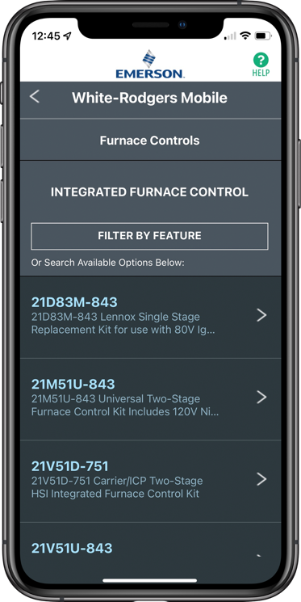
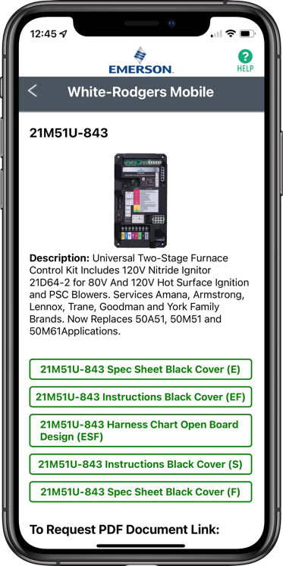
WR Mobile App
Scan the QR code to download from your app store.
Always up-to-date and easy to use
Search by OEM, competitive,
or White-Rodgers model number
Try the desktop version at https://wrcrossref.com
Your resource for:
Product information and spec sheets
Complete Cross Reference
OEM compatibility
Installation information and videos
Wiring diagrams
Priority technical help
Search
Scrollable
Product List
White-Rodgers Replacement

Slide 18
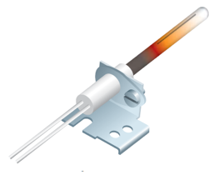
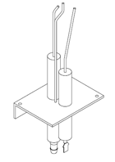
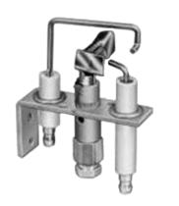
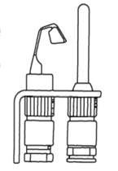
Classification by Ignition Source
 | DIRECT BURNER IGNITION |  | PROVEN / INTERMITTENT PILOT | STANDING / CONTINUOUS PILOT
 | Hot Surface Ignition (HSI) | Direct Spark Ignition (DSI)
W-R Valve | 36J, 36H, or 36G | 36J, 36H, or 36G | 36H or 36G | 36C
Ignition Source
 | Resistive element that heats up to light the gas with direct or indirect flame sensor | Ground electrode, with spark electrode flame sensor | Pilot burner to ground, with a spark electrode and flame sensor | A traditional pilot burner with a thermocouple - no spark electrode or flame sensor
Usage | Majority of current furnaces | Selected applications | Mostly packaged unit applications | No longer used in OEM production for residential HVAC
Notes:
The three categories of ignition type are:
Direct burner ignition (HIS or DSI)
Proven pilot (intermittent pilot is another term for the same type)
Standing pilot (continuous pilot is another term for same type)
Packaged units (also called rooftop units) contain the heating and air conditioning units in one case. Can be used in both commercial and residential applications

Slide 19
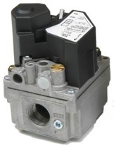
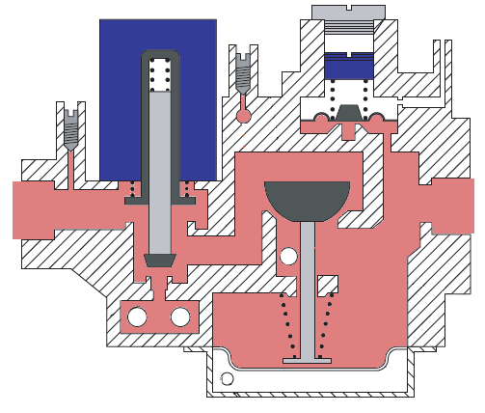
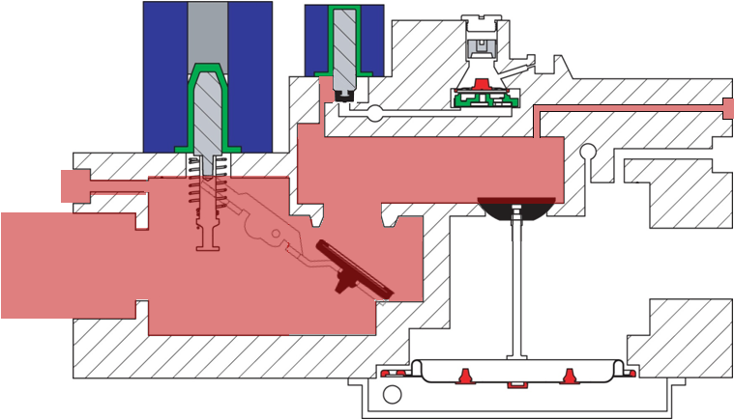
36H vs 36J Valve Flow Pilot Outlet Comparison
Pilot outlet
36H
36J
TECH TIP: The 36J does not have a pilot outlet and can only be used on direct burner ignition applications such as Direct Spark or Hot Surface Ignition.
Notes:
Any gas valve used on a proven pilot or standing pilot system will have an outlet that connects the pilot valve to the pilot tubing

Slide 20
Classification by Rated Valve Capacity
Pressure drop
  Valves are rated at 1” W.C. of pressure between inlet and outlet readings in the fully open position
Reducing bushing
  Connector sizing determines
  cubic feet per hour and overall capacity
Connected to gas manifold
Open to atmosphere
1” PRESSURE DROP WITH BUSHINGS
36C Valve | N.G. | L.P.
½ x ½ | 230,000 | 372,600
½ x ¾ | 230,000 | 372,600
¾ x ¾ | 280,000 | 453,600
3
2
1
3 1/2 “W.C.
0
1
2
3
Notes:
The pressure regulation (pressure drop) performed by a gas valve will limit the amount of fuel passed through the burners, which limits the input BTU of the furnace
The inlet and outlet sizes (modified by the reducing bushings) will also limit the number of cubic feet per hour of fuel that can pass through the burners
Limiting the supply will have a limiting affect on the flame quality and BTU output of the furnace
The bushing table in the lower right-hand corner refers to how changing the inlet and outlet pipe size affects the flow rate (Btu input)

Slide 21
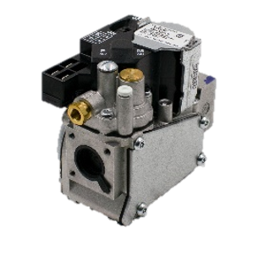
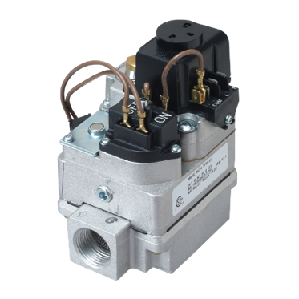
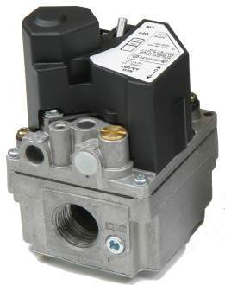
Classification by Rated Valve Capacity
Range of Regulation
The minimum and maximum BTU/Hr capacity of the valve to maintain regulation pressure settings
W-R VALVE | PIPE SIZE | RANGE OF REGULATION 1,000 BTU/HR (MIN TO MAX)
 |  | N.G. | L.P.
36J | ½ x ½ | 40 to 210 | 60 to 340
36H | ½ x ¾ | 30 to 290 | 30 to 469
 | ¾ x ¾ | 50 to 400 | 81 to 648
36G | ½ x ½ | 40 to 210 | 60 to 340
36C | ½ x ¾ | 30 to 290 | 30 to 469
 | ¾ x ¾ | 50 to 400 | 81 to 648
36G
36J
36C
36H
Notes:
The regulator is adjustable, so the BTU/Hr has a range
The manifold and spud/orifice assembly should be sized to maintain the proper input BTU rating at 3.5 “W.C. outlet pressure

Slide 22
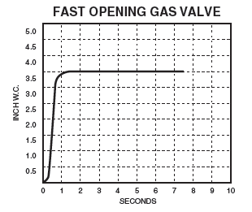
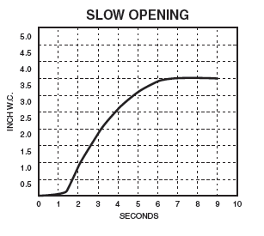
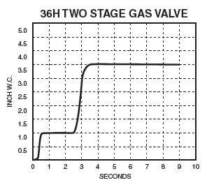
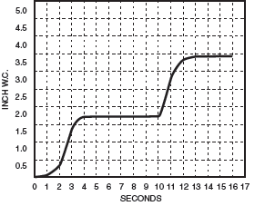
Classification by Opening Characteristics
Below are family model numbers.
Verify specific model numbers before replacing any control.
FAST OPEN | SLOW OPEN | 2-STG FAST OPEN | 2-STG SLOW OPEN
36J22, 36H32, 36G32, 36C03 | 36J24, 36H33, 36G33 | 36J54, 36H64 | 36J55, 36H65
Fast Open Fast rise to full outlet pressure upon energizing the valve | Slow Open Slow increase of gas to full outlet pressure for smoother ignition | Two-Stage Open Low pressure 1st stage (low fire) and then full outlet pressure on a call for 2nd stage heat. Can be fast or slow open on both stages
Notes:
Note the steps on the two-stage gas valves
They open to the low-fire set pressure, then to the high-fire pressure as needed

Slide 23
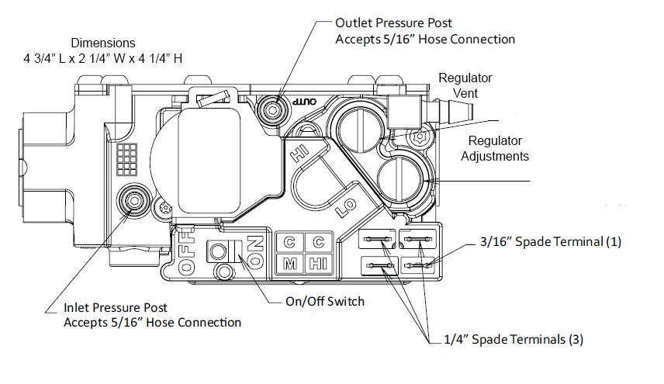
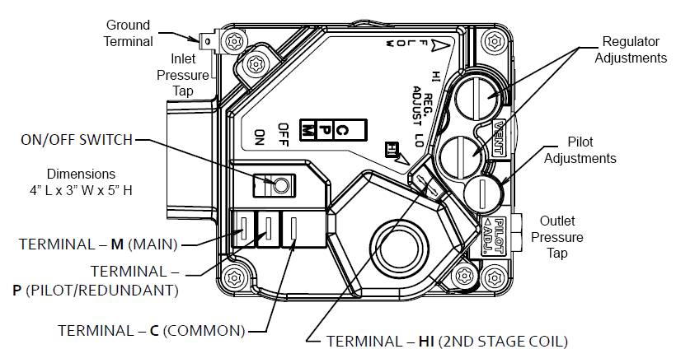
Location and Dimensional Considerations
3 ¾” L x 2 ½” W x 4 ¼” H
4” L x 3” W x 5” H
36J
36H
TECH TIP: When replacing a gas valve, the swing radius may result in having to remove the manifold from the combustion vestibule.
Notes:
The correct valve should fit into the furnace without any modifications

Slide 24
Universal Valves to Keep on Hand
MODEL NUMBER | IGNITION SOURCE | N.G. CAPACITY 1” PD | L.P. CAPACITY 1” PD | PIPE SIZE | OPENING CURVE | STAGES | % OF OEM USAGE
36J22-214 | Direct Burner Ignition (HSI / DSI) | 140,000 | 226,800 | ½ x ½ | Fast | 1 | 28%
36J24-214* |  |  |  |  | Slow | 1 | 47%
36J54-214 |  |  |  |  | Fast | 2 | 25%
36J55-214* |  |  |  |  | Slow | 2
* 36J valve is offered in a -614 Version that gives you a 90° Bottom Outlet—Primarily used in Carrier Furnaces
36H32-304 | Direct Burner Ignition or Proven Pilot | 260,000 | 421,000 | ½ x ¾ | Fast | 1 | 69%
36H32-423 |  | 300,000 | 486,000 | ¾ x ¾ | Fast | 1
36H33-412 |  |  |  |  | Slow | 1 | 12%
36H64-463 |  |  |  |  | Fast | 2 | 19%
36H65-401 |  |  |  |  | Slow | 2
36G32-500 | HSI / DSI or Proven Pilot | 140,000 | 226,800 | ½ x ½ | Fast | 1 | Replacement Only
36G33-500 |  | 140,000 | 226,800 | ½ x ½ | Slow | 1
36C03-300 | Standing Pilot | 230,000 | 372,600 | ½ x ¾ | Fast | 1 | Replacement Only
36C03-433 |  | 280,000 | 453,600 | ¾ x ¾ | Fast | 1
Notes:
Unique valves for specific applications sit on trucks for way too long
Universal replacement valves move quicker
Keep your truck stock fresh

Slide 25
WR Mobile App
Scan the QR code to download from your app store.
Always up-to-date and easy to use
Search by OEM, competitive,
or White-Rodgers model number
Try the desktop version at https://wrcrossref.com
Your resource for:
Product information and spec sheets
Complete Cross Reference
OEM compatibility
Installation information and videos
Wiring diagrams
Priority technical help
Search
Scrollable
Product List
White-Rodgers Replacement

Slide 26
Replacing Gas Valves
Part Three

Slide 27
Best Practices
Do not short out terminals on gas valve or primary control to test. Short or incorrect wiring can cause equipment damage, property damage, and/or personal injury.
This control is not intended for use in locations where it may come in direct contact with water. Suitable protection must be provided to shield the control from exposure to water (dripping, spraying, rain, etc.).
Clean gas piping of contaminants, cutting fluid, or other chemicals which might react harmfully with the gas valve components before install.
When performing service or maintenance on equipment, visually inspect the equipment for code violations and safety hazards and inform the equipment owner of the need for repair.
36G
36J
36H
36C

Slide 28
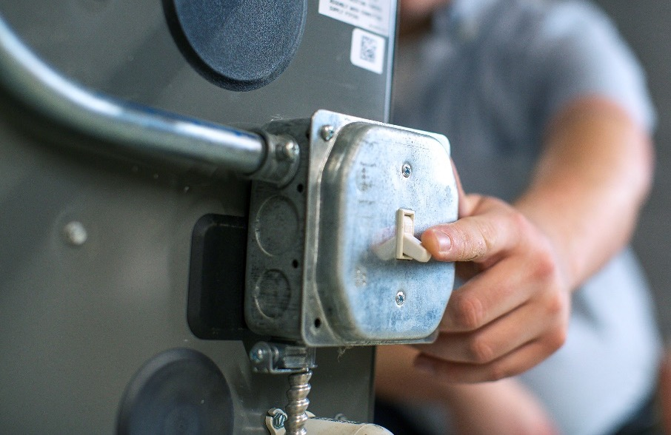
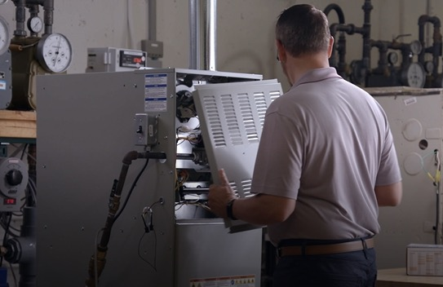
Gas Valve Replacement
Turn off the power and gas to the furnace and remove the access panels.
Notes:
Once you’ve identified the gas valve as the root fault and chosen the proper replacement, it’s time to make the repair

Slide 29
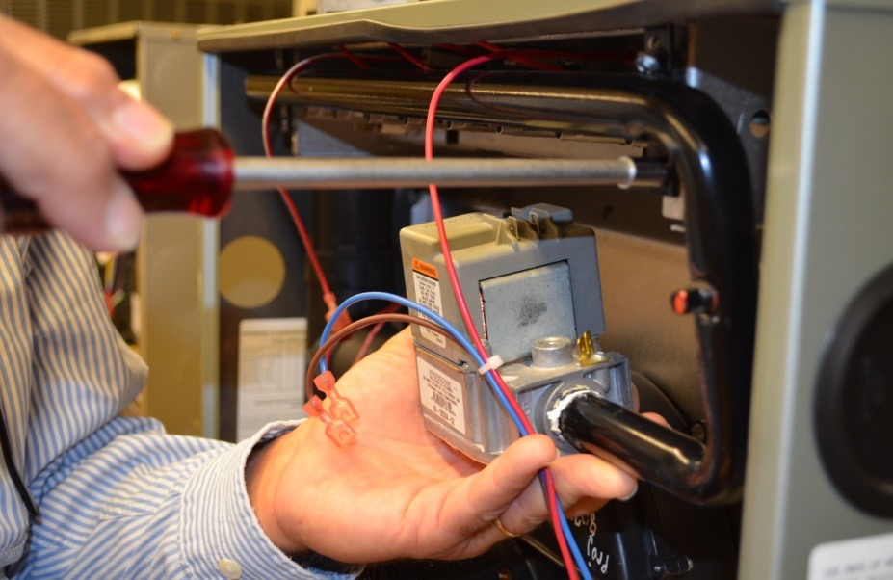
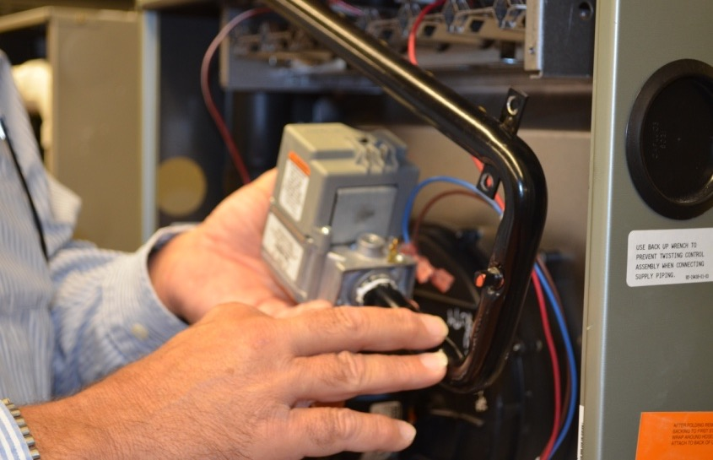
Gas Valve Replacement
If the equipment does not accommodate the swing radius of the gas valve, the manifold may be removed from the burners.
Remove manifold mounting screws
Remove gas valve from the manifold
Handle the manifold carefully so the spuds are not damaged, and the orifices maintain their proper size and shape.
Notes:
If the spuds become damaged and cause the orifices to become misshapen, the fuel will pass through them erratically
With inshot burners, proper spud and burner alignment is vital, as a misaligned assembly can cause flame impingement
Flame impingement is when the combustion reaction (flame) makes direct contact with the metal surface of the heat exchanger
This results in heat being removed from the chemical reaction too quickly, limiting the efficiency of the reaction and possibly creating carbon monoxide

Slide 30
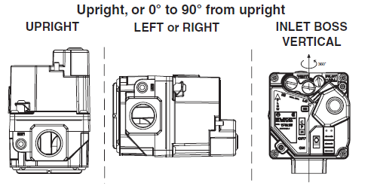
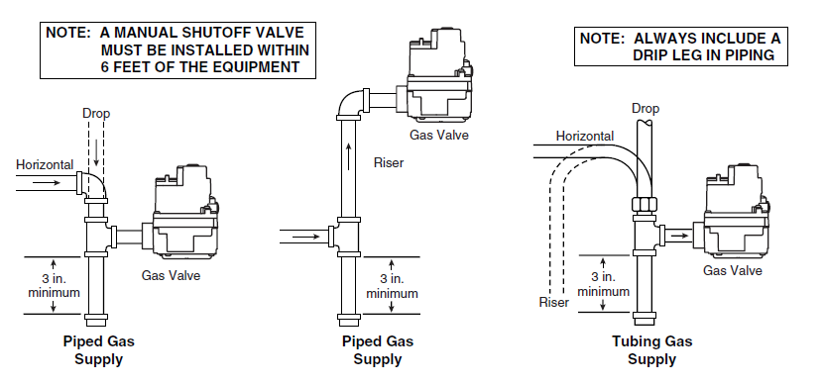
Installing the Replacement Gas Valve
Mounting Orientation
36J and 36G valves are multi poise and can be installed in any orientation
36H must be mounted upright or up to 90° from upright
Gas Piping Requirements
Drip legs must be installed upstream of the appliance at the lowest spot in the gas train
Manual shutoff must be within six feet of the appliance
36H Mounting Positions:
OEM Recommended Piping:

Slide 31
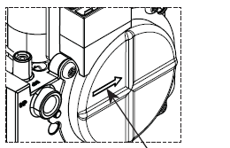
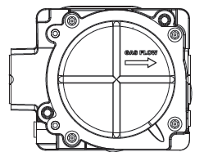
Flow Direction
36J
36H
Gas flow direction
The arrow on the valve body indicates the required direction for gas flow
  The arrow points from the supply inlet to the manifold outlet
On the 36J and 36G models, the arrow is on the side
On the 36H model, the arrow is on the bottom
Notes:
Gas valves will not function if they are installed backwards
Remember: it is the inlet pressure that opens the main valve

Slide 32
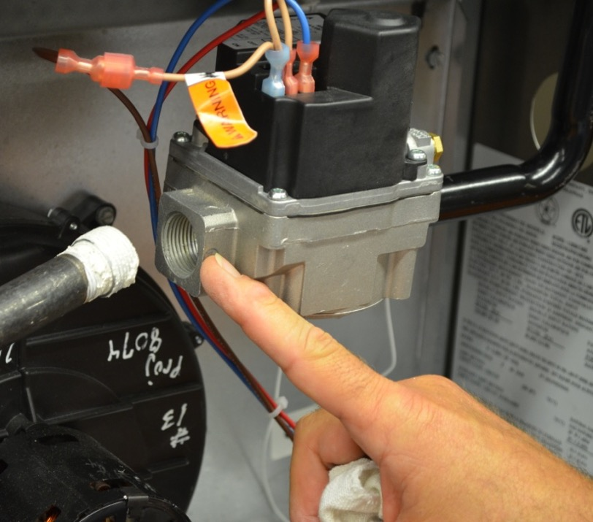
Piping Connections
Ensure the threads of the supply pipe are clean and free of rust, scale, burrs, chips, and old joint compound.
Apply pipe joint compound (pipe dope) to the male threads only.
  NOTE: Do not apply compound to the first two threads.
Inlet boss
Notes:
Be sure to leak check all your connections

Slide 33
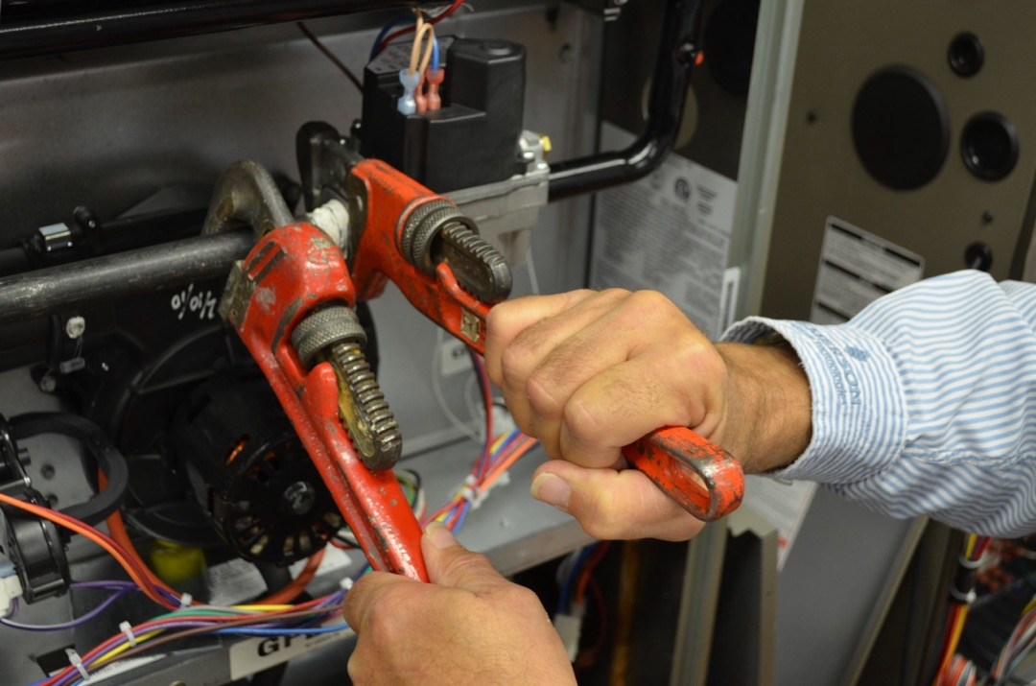

Installation Technique
Always use a back-up wrench when tightening to prevent the valve from rotating on the manifold connection.
Ensure the manifold piping does not move and misalign the burners or spuds—this can cause flame impingement.
Caution: the cast aluminum inlet boss can crack if too much torque is applied.
Notes:
The cast aluminum inlet boss will become marred by the teeth on a pipe wrench
A large adjustable wrench will grip the machined surfaces neatly without marring it cosmetically
Flame impingement is when the flame contacts the metal surface of the heat exchanger and draws the heat out of the combustion process too quickly
Flame impingement inhibits combustion and produces carbon monoxide

Slide 34
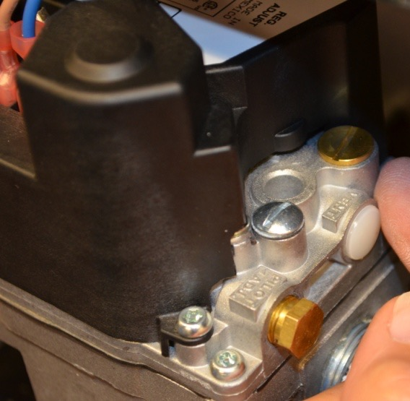
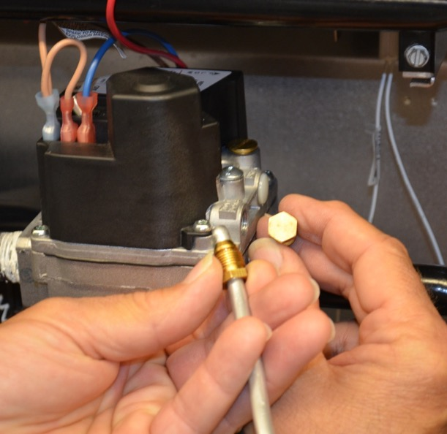
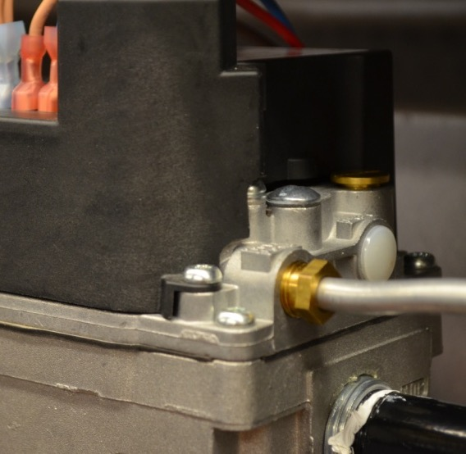
36H and 36G Pilot Tubing Installation
For furnaces with proven/intermittent pilot ignition:
Remove pilot plug
Install new pilot compression fitting
Tighten until the ferrule breaks loose, then a half turn more
Notes:
If you are installing a gas valve on a standing or intermittent pilot system, cur off the old compression fitting and install a new one when you reconnect

Slide 35
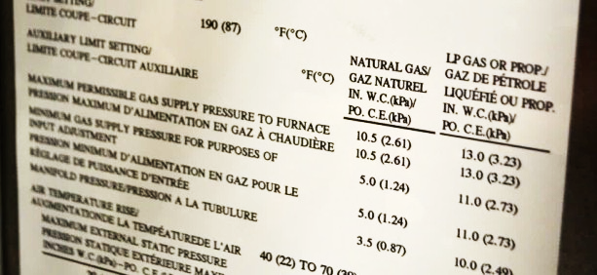
Verifying and Setting the Gas Pressure
Check the system manufacturer’s data plate for minimum/maximum supply pressure and recommended manifold pressure.
Maximum 10.5 “ W.C.
Minimum 5.0 “ W.C.
Manifold 3.5 “ W.C.
Notes:
Every time a new furnace is installed or a gas valve is replaced, the supply pressure must be verified and the outlet pressure must be adjusted
The manufacturer’s recommended pressures are rated at sea level and may need to be adjusted for altitudes higher than 2000 feet

Slide 36

Measuring Pressure in Inches of Water Column
Low pressures are often measured in inches of water column or “W.C.
In a water manometer, 1 inch of water column is literally the amount of force it takes to raise the column of water by 1 inch
While some water manometers are still in use, the vast majority are either dial or digital gauges that use the same scale
Water column gauges are calibrated at atmospheric pressure for the location
Connected to gas manifold
Open to atmosphere
3
2
1
3 1/2 “W.C.
0
1
2
3
TECH TIP: For a manometer or magnehelic gauge to be properly used, they must be recalibrated to zero before each use to compensate for changes in elevation and barometric pressure.
Digital manometer
Notes:
Every time a new furnace is installed or a gas valve is replaced, the supply pressure must be verified and the outlet pressure must be adjusted
The manufacturer’s recommended pressures are rated at sea level and may need to be adjusted for altitudes higher than 2000 feet

Slide 37
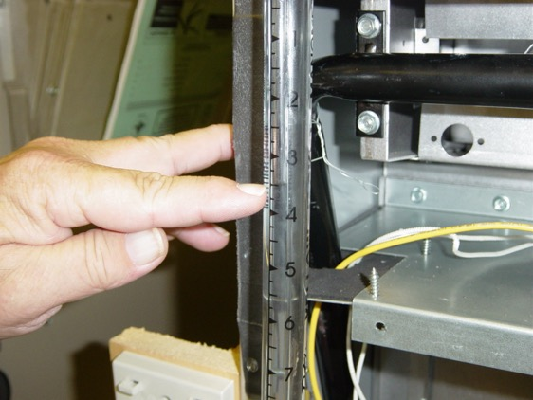
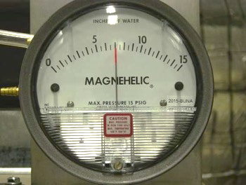
Inlet Gas Pressure WC Settings
PSI TO INCHES OF WATER COLUMN CONVERSION
28” WC | Equals | 1 PSI
14” WC | Equals | ½ PSI
7” WC | Equals | ¼ PSI
OPERATING PRESSURES | MAX. INLET PRESSURES ”WC | MIN. INLET PRESSURES ”WC
NG – Natural Gas | 14” | 5”
LPG – Liquid Petroleum | 14” | 11”
Magnehelic gauge
Water manometer with one-inch increments
Digital manometer
Notes:
Always check the manufacturer’s data plate to find the minimum and maximum inlet pressures
If the inlet pressure is below the manufacturer’s requirement, check the gas line sizing, check for blockage, and check the pressure at the main regulator
Check with the gas supply company for any requirements or restrictions concerning adjusting the main regulator pressure

Slide 38
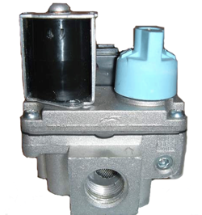





Locating Gas Pressure Taps
Two styles of pressure test ports:
Removable plug for use with 1/8” MPT/barbed adaptor
Integrated tower-style pressure tap for use with 5/16” ID tubing adaptor
Notes:
Both the inlet and outlet pressures can be measured at the gas valve

Slide 39

Locating Gas Pressure Taps
Locate the pressure test port for both the inlet (supply) pressure and the outlet (manifold) pressure.
36J
Notes:
The tower-style pressure taps are also called bosses on some technical drawings

Slide 40



Gas Valve Replacement
If the equipment does not accommodate the swing radius of the gas valve, the manifold may be removed from the burners.
Valve screw
Tower
(boss)
Inlet pressure tap
Outlet pressure tap
TECH TIP: Ensure gas supply is shut off when opening pressure taps to connect manometer tubing.
Notes:
Do not remove the valve screw
It only needs to be rotated a half-turn to release enough pressure for testing
On the 36J, the outlet pressure tap is adjacent to the solenoid tower and is not the port labeled “Vent”

Slide 41


Measuring Pressure
Fit 5/16” ID tubing adaptor over pressure tap boss
Gas pressure can only be accurately tested during a call for heat
  Measuring inlet pressure without gas actively flowing through the valve is a dead-head reading that will not reveal any line pressure issues
Inlet (supply) pressure
Outlet (manifold) pressure
Notes:
Inlet pressure must be measured while the burners are lit. Gas must be flowing through the valve for a proper reading. The pressure drops when the valve opens and must stay above the minimum required amount.

Slide 42

Plastic Barbed Fitting on the 36J
A 90° plastic hose barb is found on some 36J controls
  This is not an outlet pressure tap
  Used on systems with sealed combustion chambers to vent gas and equalize regulator pressure
  Connected to burner box with flexible tubing
Barbed vent fitting not used for outlet pressure
Notes:
This is the barbed fitting that connects the vent to the burner box on a sealed combustion system.
Without the barbed fitting, the vent looks very similar to the pressure tap

Slide 43

HSI Simulator Breakout
Identifying Pressure Test Ports
Notes:
On the 36J gas valve, point out the location of the Inlet (Supply) Pressure Test Port, the Outlet (Manifold) Pressure Test Port, the brass cap covering the Regulator Adjustment Screw, and the barbed fitting on the Regulator Vent

Slide 44



Connecting 1/8” MPT/Barbed Adaptor
For furnaces with proven/intermittent pilot ignition:
Remove plug using 3/16” hex key
Insert MPT adaptor into threaded test port
Auxiliary port on manifold may be used (if present)
Notes:
Barbed fitting is threaded into test port, then the manometer tube is connected to the fitting

Slide 45


Adjusting Manifold Pressure
Remove cap to access the manifold adjustment screw.
Use screwdriver to turn regulator adjustment screw.
Clockwise increases outlet pressure
Counterclockwise decreases outlet pressure
TECH TIP: Adjust in small increments: less than one quarter turn.
Notes:
The cap covers the adjustment screw so it does not get accidentally adjusted
The adjustment screw is usually a nylon (plastic) screw
This is the same piece that is removed to change the regulator spring when converting from natural gas to propane
The screw should never be tight and require excessive force to break loose
Pressure should only be adjusted during an active call for heat with a manometer connected
Pressure is immediately reflected on the manometer

Slide 46





Adjusting Manifold Pressure on Two Stage Valve
Check the data plate for manufacturer’s recommended pressure settings
Adjust high fire first
Adjust low fire second
TECH TIP: After adjusting both high and low fire, go back and check/fine tune pressures.
High fire
Low fire
Notes:
The furnace should be calling for first stage heat only when adjusting first stage pressure (make sure W2 is not energized)
Furnace should be calling for second stage heat when adjusting high fire (W2 should be energized)

Slide 47


Adjusting Regulator and Pilot on the 36H/36G
Pilot and manifold pressures are adjusted independently.
Pilot adjust
Manifold adjust
TECH TIP: The pilot adjust screw must be turned in the opposite direction to adjust the pressure, clockwise reduces and counterclockwise increases.
Notes:
Note that the pilot adjustment screw turns the opposite of the regulator adjustment screw
There is no pressure tap for the pilot pressure
Observe the pilot flame – it should touch the thermocouple but not be fluttering
Measure the millivolts on the thermocouple (looking for 15-30)

Slide 48


Converting from Natural Gas to LP
Remove regulator cover screw
Remove plastic adjust screw
Extract regulator spring for natural gas
Replace spring with LP spring from conversion kit
Replace plastic adjust screw and set manifold pressure
TECH TIP: Check with furnace manufacturer to ensure proper orifice size requirements for liquefied petroleum gas.
Notes:
This is the same screw that adjusts the outlet pressure
Natural gas springs and LP springs have different tensions to set the correct pressures

Slide 49
Troubleshooting and Servicing Gas Valves
Part Four

Slide 50

When to Replace a Gas Valve
If there is no heat and:
  There is a valid call for heat from the thermostat
  There is no clicking sound when the valve is energized
  There is no measurable pressure at the outlet
If the system efficiency is down and:
  Other causes have been ruled out
If the outlet pressure remains above the set point or fluctuates, it is not operating properly
  The manifold regulation should stabilize after about
  20 seconds and stay within +/- 10% of the set
  pressure setting
If the gas valve has been subjected to water flooding
If the manifold pressure cannot be adjusted

Slide 51

Troubleshooting Gas Valves - Electrical
When the solenoid coil is energized, the redundant and main valves are drawn open.
When the coil is deenergized, the return spring closes the valves.
When the coil is energized, 24V can be measured
between the two terminals.
If 24V is present at the solenoid and there is inlet pressure but no outlet pressure, the valve has failed to open.
A stuck plunger (seized solenoid) will cause an increase in current that can cause the low voltage fuse to blow.
A grounded solenoid coil (wire from coil touching valve body) will cause an overcurrent and blow the low voltage fuse.
Magnetic coil
Return springs
Redundant valve
Main valve
Notes:
A solenoid is a coil of wire that forms an electromagnet when it is energized.
The electromagnet draws the valve actuator into the open position.
When it is deenergized, the spring snaps the valve back into the closed position.

Slide 52

Troubleshooting Gas Valves - Mechanical
High outlet pressure
Regulator set too high
Can increase overall system temperature rise and outlet temperatures
Can cause burner liftoff/noise and flame impingement
Can overheat/perforate heat exchanger
Can permanently damage the diaphragm
Results from dirty or clogged internal bypass channels in regulator body
Corrosion and contamination due to excessive moisture or flooding
Can result in slowing the closing action of the valve
Adjustment screw
Adjustment Spring
Vent
Valve seat
TECH TIP: Visually inspecting the main burner flame cannot accurately determine if the pressures are within the manufacturer’s specifications.
Diaphragm
Notes:
A perforated heat exchanger is another term for a cracked heat exchanger
If a gas valve goes through a flood – underwater in a basement or such – it must be replaced
Check with the furnace manufacturer: many manufacturers will condemn the entire appliance and suggest it be replaced due to water damage and mold potential

Slide 53
Troubleshooting In-line Gas Regulators
The regulator spring is designed to maintain a set pressure regardless of upstream fluctuation.
As the supply pressure increases, it puts back-pressure on the diaphragm and spring, forcing the valve to close.
Adjustment screw
Regulator adjustment spring
Vent
Diaphragm
High pressure in
Low pressure out
Valve seat
Notes:
This regulator is similar to one found on a supply gas line, and not the regulator integrated into a modern gas valve.
It is here as a reference to illustrate how the regulator in a gas valve operates.
In this drawing, the regulator adjustment spring is shown holding the regulator valve open.
As the inlet pressure passes through the regulator valve, it pushes on the diaphragm and compresses the adjustment spring.
This causes a reduction in pressure passing through the regulator valve.
This action allows the regulator to maintain a fixed outlet pressure when the inlet pressure changes.

Slide 54


Troubleshooting In-line Gas Regulators
The internal diaphragm must flex to effectively regulate the pressure.
Pressure buildup on back side of the diaphragm will cause an increased outlet pressure.
Excessive back-pressure must be vented to atmosphere to maintain proper flexibility and pressure regulation.
TECH TIP: Ice buildup on the outdoor regulator can prevent venting and cause increased gas pressure entering house.
Notes:
If the vent on the back side of the regulator diaphragm were to become blocked, the diaphragm wouldn’t be able to flex and the spring wouldn’t be compressed when the inlet pressure increased.
This would prevent the regulator valve from closing to regulate the outlet pressure.
This could result in excessive outlet pressure.
Modern gas valves also have a vent on their regulators to allow the diaphragm to flex and maintain the outlet pressure.

Slide 55
Results of Gas Valve Contamination
Opening orifice
Corrosion or contamination in either orifice will greatly affect the outlet pressure.
Control gas orifice
Opening orifice
Notes:
These are the ports that cause the gas valve to open and close. If they are obstructed, the valve will not operate as designed and may become a safety hazard.

Slide 56

36J Hot Surface Ignition or Direct Spark Ignition
Valve solenoid energized by 24 volts from IFC or ignition module.
Notes:
On this wiring diagram, the gas valve is shown being energized by 24V from the integrated furnace control (MV terminals)
The main valve and the redundant valve are wired in parallel and both open and close at the same time

Slide 57

36H and 36G Intermittent Ignition (Proven Pilot)
Pilot valve and main valve are controlled independently by ignition module.
Notes:
In this wiring diagram, the main valve and the pilot valve are controlled independently
The pilot valve is the same as the redundant valve
When it is energized (PV), it opens and allows fuel to flow through the tube to the pilot burner
The spark electrode then fires and ignites the pilot
The pilot flame proves through flame rectification
The main valve is then energized (MV) and it opens to allow fuel to pass through the burners and be ignited by the pilot

Slide 58
Key Takeaways
A proper understanding of the sequence of operation is a valuable tool in the technician’s troubleshooting kit
Having a wiring diagram of the IFC and the furnace helps the technician trace wiring and find faults
Most IFC boards display fault codes which assist the technician in troubleshooting
For additional information, consult the manual included with the replacement universal controller or visit White Rodgers Education Central https://go.bluevolt.com/whiterodgers

Slide 59

White-Rodgers Comprehensive Solutions Delivered
Industry Leading Products
Used by more OEM’s
Offering the widest range of Universal HVAC parts
Ease of Installation
Simple, easy to understand instructions
Standard wiring nomenclature
Reliability of Product
Quality control provides reliable products
Affordable
Competitive prices
Supported by Knowledgeable Representatives
Contractor direct phone support
R-5832 (11/23)

